Slide 1







Class Name
Group 2
Date
T2307A – FPT Aptech Hanoi
Dec 18 2024
Symphony
Limited

Slide 2




Member
Đỗ Thị Diệp Quyên
Nguyễn Anh Ngọc
Nguyễn Thanh Phong
Nguyễn Quốc Khánh

Slide 3
Introduction
Symphony Ltd. is private institute, which generally conducts the classes and training materials for the various certifications that are related to IT and Software industries like networking related, Java related, database related like for SQL Servers, oracle, etc. They are one of the famous institutions which have spread in to various branches situated at different location in the state.

Slide 4






Technology

Slide 5

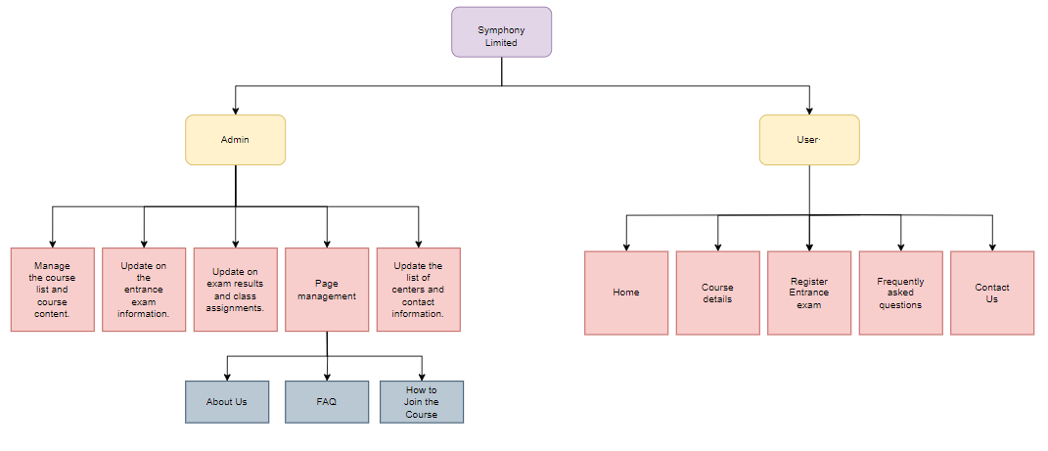
Site map

Slide 6
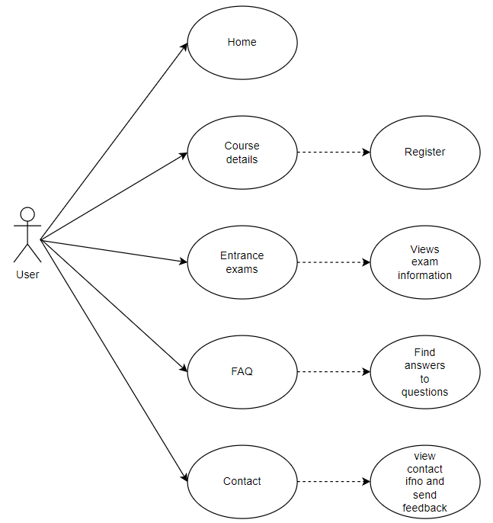

Use case (user)

Slide 7
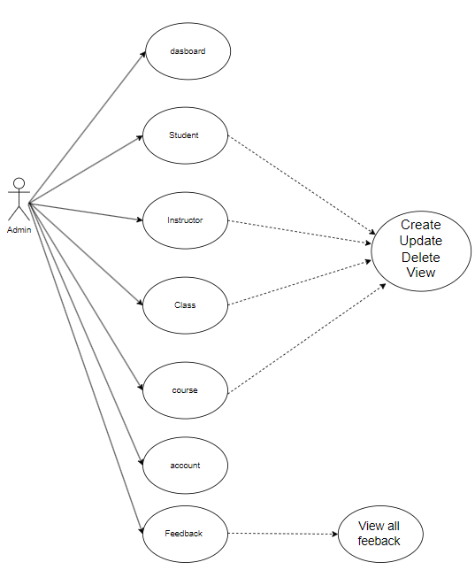
Use case (admin)

Slide 8
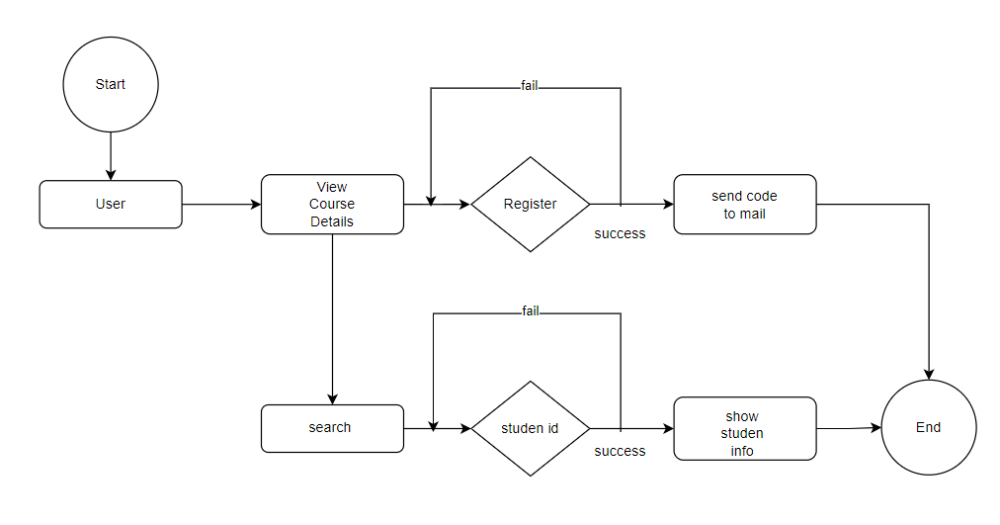
Fl0w chart (home)

Slide 9
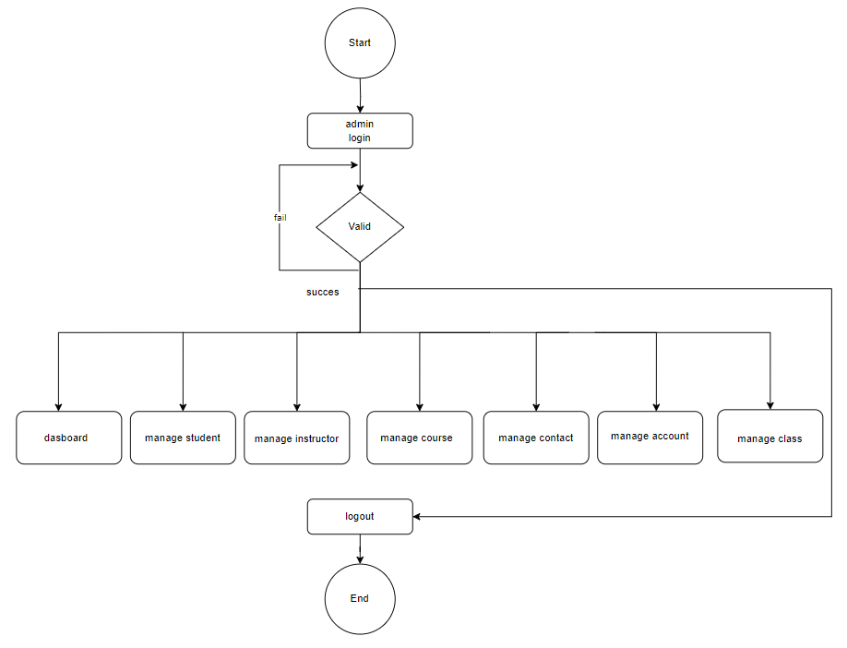
Fl0w chart (admin)

Slide 10
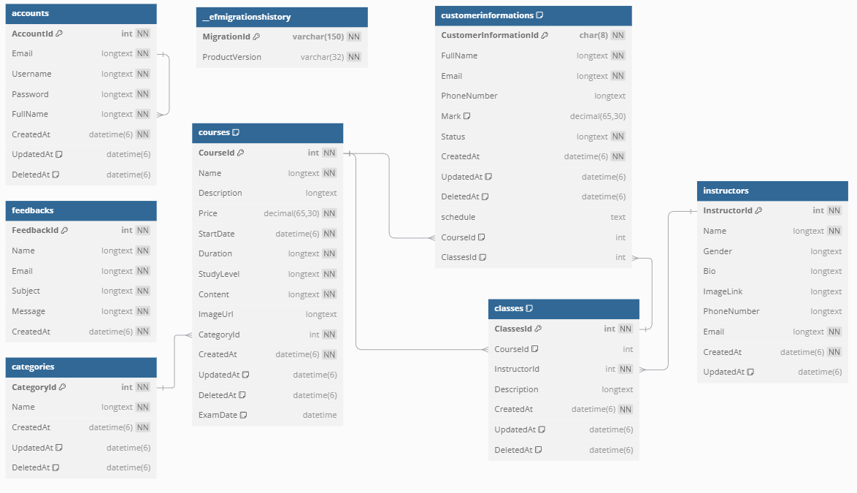
Database

Slide 11



Demo

Slide 12





Thank
You
teachername@school.edu
(123) 456-7890
Mondays and Wednesdays, 3 PM - 4 PM

